Slide 1
2
Bab
Risk to Safety, Health and Environment: Perception, Assessment and Management
Disusun oleh Tim Dosen K3L FTUI
Genap 2019/2020

Slide 2

Is it a risky place to work ?

Slide 3


Slide 4
Outline of talk
Introduction
Risk perception
Risk assessment
Risk analysis and management
Fault tree analysis
Event tree analysis
Environmental Risk Assessment
Problems
Reference :
Charles A. Wentz, Safety, Health and Environmental Protection, MGH, 1998.

Slide 5
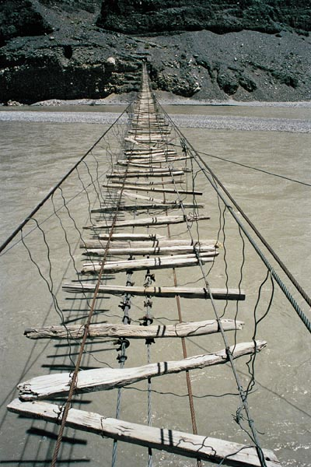
Introduction
There is some risk in every decision or action. This risk is present in all industrial, government, public, and personal situations.
In order to appraise risk and safety, quantitative methods are preferred because they are more disciplined and objective than purely subjective conclusions.
Even quantitative methods often involve some degree of subjectivity that introduce uncertainty.
5

Slide 6

Risk perception
The perception of risk depends a great deal on our personal situation. We take numerous risks daily with little, if any concern. Yet we become highly concerned about other less serious risks because of our personal perception of an activity, chemical substance, or process operation.
Everyone would like to live in a risk free environment, but is this really an attainable goal?
What about the risk of :
Drinking a glass of tap water
Having a chest x-ray for cancer detection
Cosmic radiation hazards during an air trip
The chemicals in the soap or shampoo
6

Slide 7
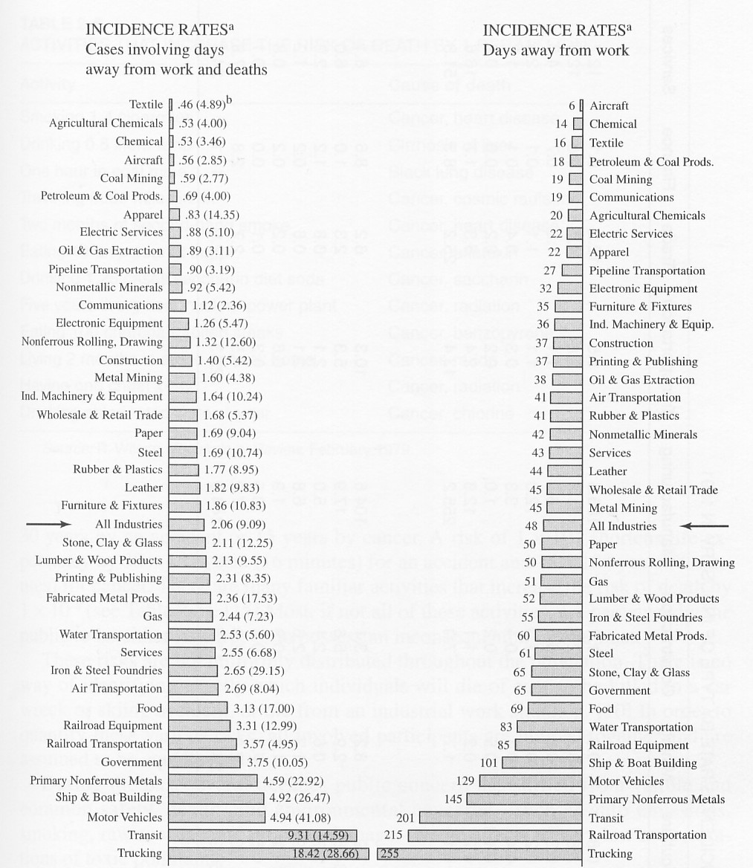
Risk perception (cont)
The public perception of risk is often different from the risk perception of industry and statisticians.
7

Slide 8
Risk perception (cont)
The identification of the precise risk or risks causes for health-related problems is a complex problem because the severity and length of exposure to a wide variety of risks during a lifetime.
The incidence rate is commonly used to measure and compare industrial occupational injuries and illnesses
The incidence rate =
(total injuries and illnesses * 200.000) or (total lost workdays * 200.000)
total hours worked by all employees during period
The 200.000 constant is based on 100 full-time equivalent workers working 40 hours a week, 50 weeks a year.

Slide 9
Risk perception (cont)
Factors affecting the acceptability of risk based on the perception of people

Slide 10
Risk perception (cont)
The basis for negative risk perception by communities for industrial facilities

Slide 11
Risk assessment
Since no activity or technology can be absolutely safe, the question arises,
“ How safe is safe enough ?”
A safety risk is defined as possible consequences for human death, disease, injury and for property destruction or damage to the environment.
Risk equals the probability of the occurrence times the severity of the harmful effects
Risk = Probability * Consequences
ALARP : As low as reasonably practicable

Slide 12
Risk assessment (cont)

Slide 13
Risk assessment (cont)

Slide 14
Risk analysis and management
Effective risk management ensures an objective, consistent response to the identified risks. This requires through planning, organizing, implementing, and controlling to achieve a successful risk management program.

Slide 15
Fault tree analysis
Methodologies to determine and evaluate process safety hazards:
What-if checklist
Hazard and operability study (HAZOP)
Failure mode and effects analysis (FMEA)
Fault tree analysis
An appropriate equivalent methodology

Slide 16
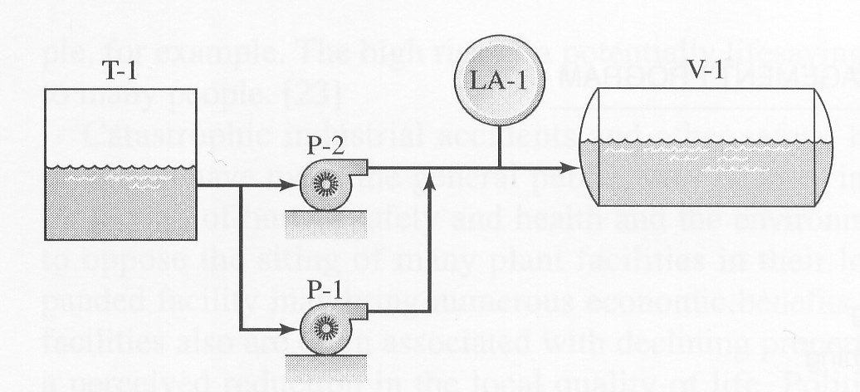
Fault tree analysis (cont)
The examination of a process, operation, and facility for potential hazards is a complex task. Generally it is best to begin with process flow diagrams and an outline of the facility lay-out.
A more detailed piping and instrument diagram (P&ID) better identifies all of the potential hazards.

Slide 17
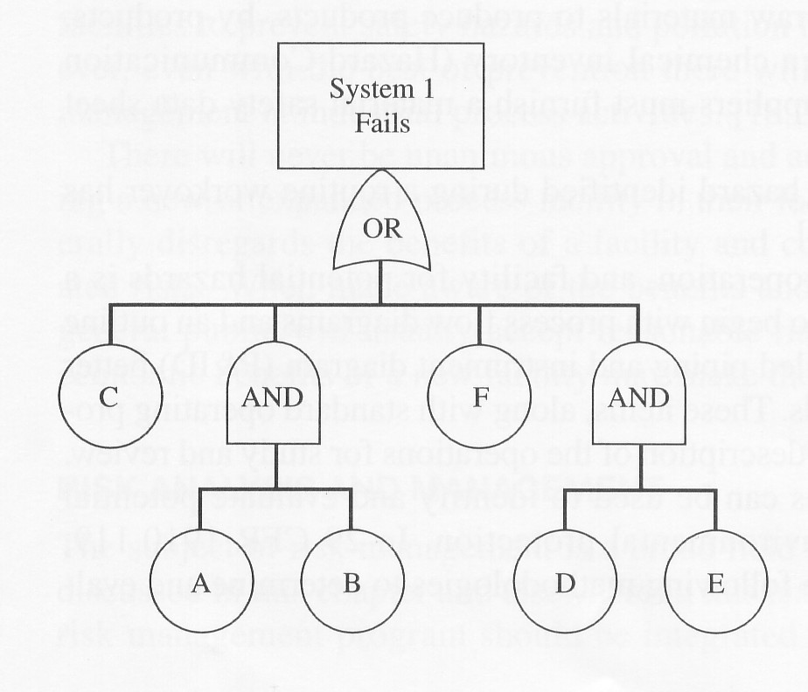
Fault tree analysis (cont)
Typical fault tree analysis.
This includes the following steps :
Define the top event
Define the intermediate events
Identify all gates and basic events
Resolve all duplication & conflict.
17

Slide 18
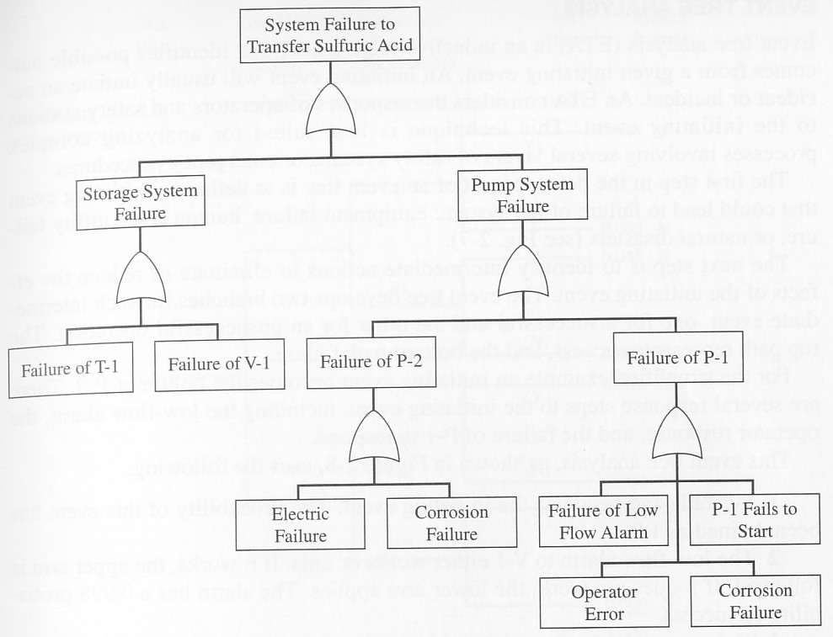
Fault tree analysis (cont)
Fault tree analysis for the fluid flow example

Slide 19
Event tree analysis
Event tree analysis (ETA) is an inductive logic model that identifies possible outcomes from given initiating event. An initiating event will usually initiate an accident or incident. An ETA considers the responses of operators and safety systems to the initiating event. This technique is best suited for analyzing complex process involving several layers of safety systems and emergency procedures

Slide 20
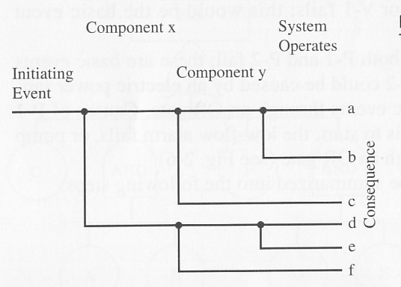
Event tree analysis (cont)
The first step is to define an initiating event that could lead to failure of the system: equipment failure, human error, utility failure, or natural disaster.
The next steps is to identify intermediate actions to eliminate or reduce the effects of the initiating event. The event tree develops two branches for each intermediate event, one for a successful and the other for an unsuccessful operation.
The top path represents success and the bottom path failure.
20

Slide 21
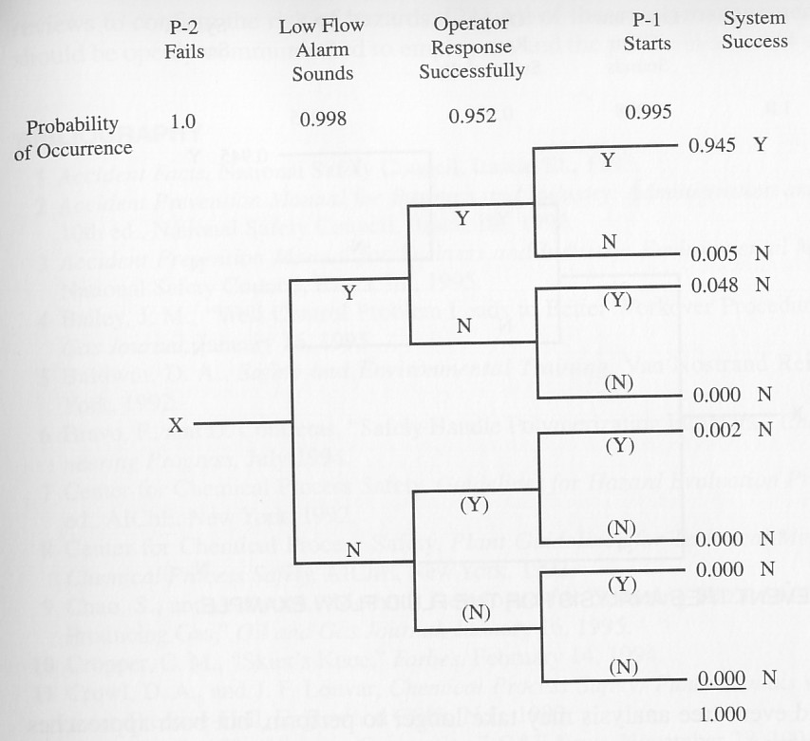
Event tree analysis (cont)
The probability of any branch of the event tree occurring is the product of the event probabilities on the branch.
Fault tree analysis for the fluid flow example

Slide 22
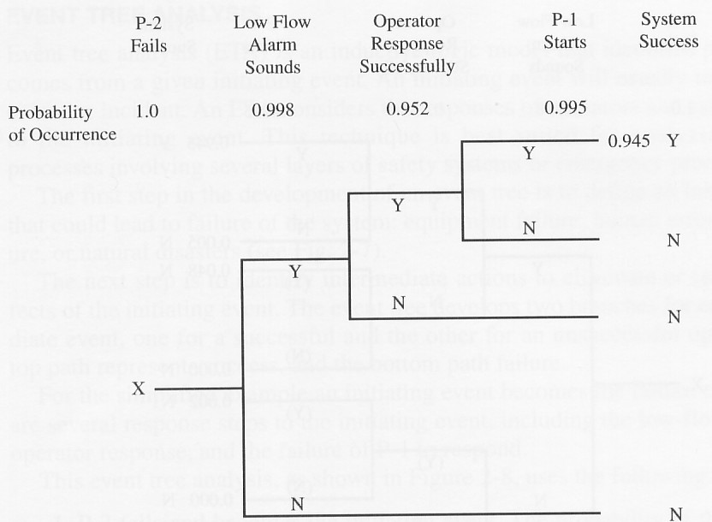
Event tree analysis (cont)
The event tree can be summarized as follows:
Identify initiating events that
could result in an accident
Identify the safety functions to
mitigate the initiating event
Construct the event tree
Describe accident sequence
outcomes and their probability.
22

Slide 23
Environmental Risk Assessment

Slide 24
What is environmental risk assessment (ERA)?
Qualitative and quantitative valuation of environmental status
ERA is comprised of:
human health risk assessment;
ecological risk assessment.

Slide 25
Systematic approach to risk assessment
ERA should be conducted when it is determined that a management action may have consequences to either humans or the environment.

Slide 26
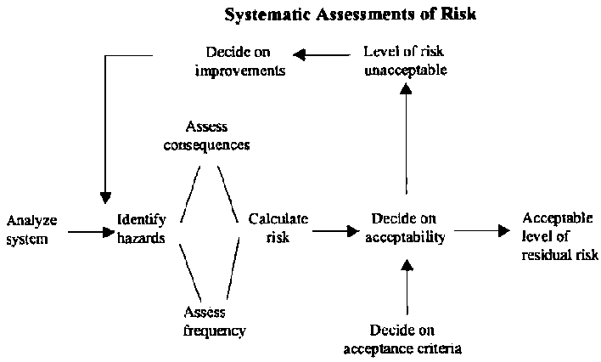

Slide 27
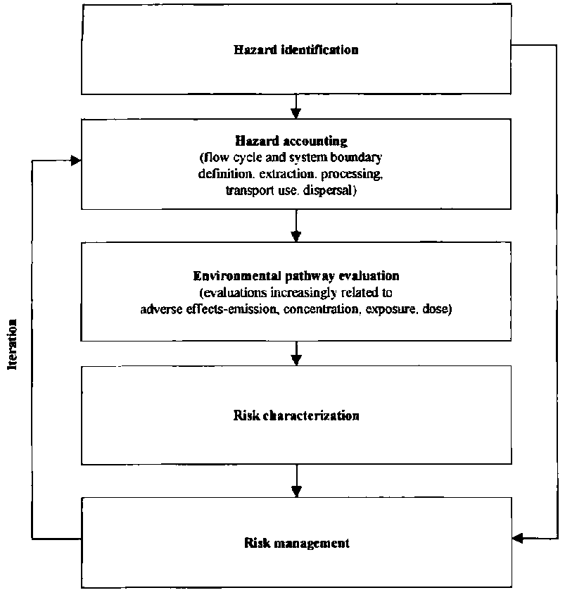

Slide 28
ERA addresses three questions
What can go wrong with the project?
What is the range of magnitude of these adverse consequences?
What can be done and at what cost to reduce unacceptable risk and damage?

Slide 29
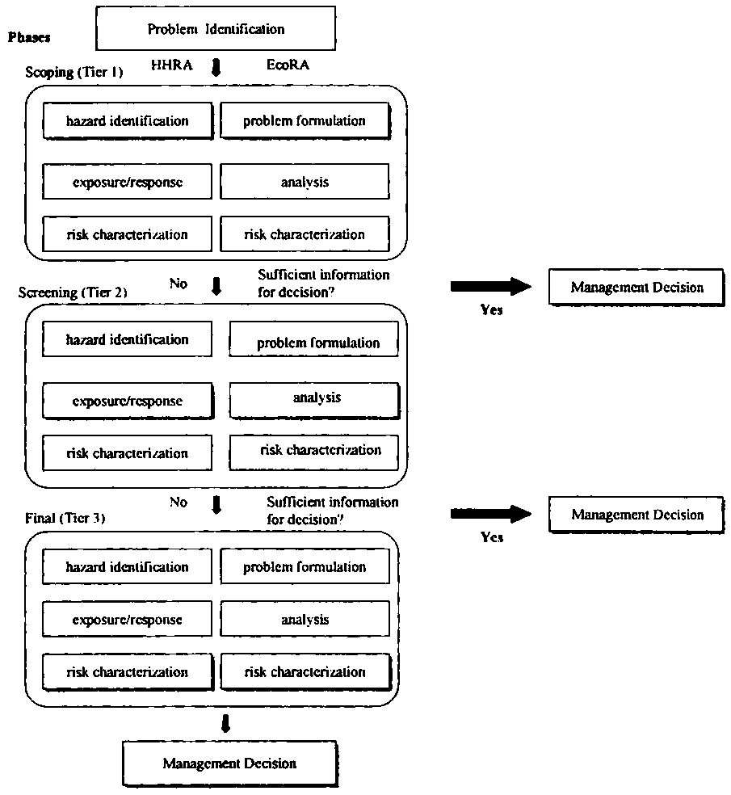
The interactive nature of ERA

Slide 30
Purposes in performing ERA
to learn about the risks
to reduce the risk

Slide 31
Risk comparison
Probability of frequency of events causing one or more immediate fatalities.
Chance of death for an individual within a specified population in each year.
Number of deaths from lifetime exposure.
Loss of life expectancy considers the age at which death occurs.
Deaths per tone of product, or per facility.

Slide 32

Case Study Environmental Risk Assessment (Ref. BIG MAP, Iowa State University)
The release of a Genetically Engineered plant to the environment requires consideration of the environmental safety of the GE plant within the context of the scale, nature, and region of deployment.
Environmental Risk Assessment (ERA) is the process which evaluates risk as the likelihood for an undesired consequence to be manifested under realistic conditions of exposure.

Slide 33

ERA considers the impact of introduction of a GE plant into a given environment.
Specific questions that are commonly addressed in
the ERA for most GE plants:
Does the modification of the plant cause it to have attributes commonly associated with weeds in managed environments? Invasiveness in natural environments?
Will the transgenic element in the GE plant move into native plant populations? And so what if it does?
Will the GE plant adversely impact non-target organisms that may be of special interest because they are beneficial, endangered, threatened, or charismatic?

Slide 34
Principles of ERA
The well-established principles of ERA are applied to the potential environmental risks of biotechnology through a process that
Defines the regulatory need (problem context)
Describes relevant concerns for analysis (problem definition);
Estimates the likelihood of exposure (exposure characterization);
Evaluates the consequence of exposure (effects characterization); and
Formulates an understanding of degree of risk (risk characterization).
http://cfpub.epa.gov/ncea/cfm/recordisplay.cfm?did=12460

Slide 35
Risk—Likelihood of an unwanted outcome
Risk is the likelihood that there will be an undesired consequence when the GE plant is present in the environment.
Fully quantitative ERA describes risk as a probability of exposure to the GE plant and the undesired consequence of the exposure.
A probability ranging from zero to one
More frequently risk is described as a likelihood or degree of concern based on a comparison of the GE plant and its uses to similar non GE plants and their uses.
There are high, low, or negligible concerns regarding the GE plant and its proposed use

Slide 36

There is always some degree of risk
Risk of anything is zero only in the absolute absence of exposure
Thus for the GE plant risk is comparative – it asks
Is the GE plant and the way it will be used riskier than the comparable non-GE plant and its uses with
which we are familiar?

Slide 37
ERA focuses on change
The undesired consequence we evaluate in the ERA is focused on a specific change that has been brought about with genetic transformation
This change may be do to
A stressor
the changed attribute of the GE plant
for instance, an expressed protein
Or an action
environmental release of the transgenic plant
for instance, release of a GE plant into a particular environment

Slide 38
ERA is a tiered process
The ERA ideally proceeds in tiers of increasing complexity
lower tiers focus on stressor-mediated effects in laboratory and glasshouse settings with well-controlled conditions
higher tiers focus on action-mediated effects
in semi-field and field environments which
are more realistic but less well-controlled.
Notes:
Define stressor?

Slide 39
Problem Formulation
Problem formulation is a formal process whereby relevant considerations for risk assessment are determined.
Problem Formulation considers –
Problem context – establishes the parameters
for the risk assessment, including policy goals, scope, assessment endpoints and methodology.
Problem definition – distills risk questions into tractable problems for analysis

Slide 40
Comparability
The problem formulation develops the plan for the ERA by first developing a baseline of comparability
To what degree are the host crop and the expressed attribute familiar?
Is the GE plant substantially equivalent to the non-GE plant in it composition and intended use?
If yes, the ERA can proceed with a focus on the changed attribute of the GE plant

Slide 41
Are the GE and non-GE crops the same?
The problem formulation should establish that the particular GE plant is substantially equivalent to the comparable non-GE plant as it is encountered and used in present-day agriculture
Data (found in the literature and/or generated and submitted by the product developer) provides the basis for the determination of substantial equivalence.
In most regulatory schemes, precursor information has already been considered in the regulatory dossier; the ERA is found as an annex to the dossier that considers ecological safety only once the substantial equivalence has been demonstrated. A good example of this process can be found in EFSA guidance for GE plant risk assessments.
http://www.efsa.europa.eu/EFSA/efsa_locale-1178620753812_1178620775747.htm

Slide 42
Precursor information for use in Problem Formulation
Precursor information establishes that other than of an changes the GE plant is equivalent to non-GE comparators.
Once equivalence is established on the basis of the GE plant characterization, the ERA is conducted with emphasis on the change.
For instance, in the problem formulation for a non target insect ERA, precursor information describes
the characteristics of the donor and recipient organisms;
the genes inserted and their expression;
agronomic performance and characteristics;
equivalence of the plant expressed protein to the wild counterpart;
compositional characteristics (nutrients and antinutrients).
This information is found in published studies and data submitted from product developers and is integrated with expert opinion and stakeholder deliberations to determine the risk hypothesis to be tested, the endpoints for consideration, and the scope of the analysis plan.

Slide 43
An example of using precursor information to focus the ERA
Cry1 Bt toxin expressed in corn for which an ERA is needed for approval of an unconfined environmental release.
The problem considers the degree to which the host crop (corn) and the expressed product (a Cry1 protein) and their combination are familiar (well-understood) in terms of
history of use;
scientific knowledge;
prior regulatory considerations; and
unique aspects of the environmental release that is being considered.
In this case,
Corn biology, production, and use are well-understood
The GE corn will not alter corn biology, production, and use
The change involved is to produce Cry1 proteins which are selectively active on Lepidoptera,
The specific selectivity of theCry1 protein can be established from literature and/or developer data
The history of use of Cry1 proteins in other GE plants and sprayable biopesticides is well-understood
There is 10+ years of experience in the environmental release of Cry1 Bt corn throughout various regions of the world
Notes:
The risk assessor in leading development of an ERA will generally assemble a team to consider the needs and nature of the proposed risk assessment.

Slide 44
Risk hypothesis
The risk hypothesis represents an assumption regarding the cause-effect relationships between sources, changes, exposure routes, endpoints, responses and measures relevant to the ERA.
A tentative explanation taken to be true for the purpose of argument or investigation
Not to be confused with scientific hypotheses which are specific, testable postulates (these are a part of the analytical phase of the ERA)
The ERA process for GE plants is comparative, so the risk hypothesis considers the comparative difference as it relates to exposure and the undesired consequences of exposure

Slide 45
The analytical plan
Addresses the specific risk hypothesis
Describes various measures to be used in the assessment and the characterizations that form the body of the risk assessment in terms of
proscribed studies to be conducted,
the appropriate tier for analysis,
the appropriate risk formulation, and
specific decision criteria that will be used for risk characterization.

Slide 46
The analysis phase
Has three main parts
characterization of exposure;
characterization of effect (a consequence of exposure); and
characterization of risk (an undesired consequence of exposure given that exposure occurs).

Slide 47
Effects characterization
The specific adverse effect of interest has been identified in the problem formulation.
In characterizing effects, the risk assessor seeks information establishing a specific adverse effect (or lack there of) of the transformation in the GE plant.
The effects characterization will use data generated at various tiers (Tiered process example) depending on the nature of the problem and the uncertainty.

Slide 48
Exposure characterization
Establishes the source, duration, intensity, and duration of exposure on the basis of expression data as well as knowledge of the crop, its management, and the environment where it will be released.
This phase of analysis can also proceed in tiers beginning with estimated environmental concentrations that are modeled from knowledge of the GE plant and the environment where it will be deployed, through to higher tiered field measurements of actual environmental concentrations

Slide 49
Environmental fate is critical to exposure characterization
Environmental fate describes what happens to the transgene and its expressed product in the environment.
Two relevant examples are soil degradation and gene flow.
If soil degradation studies show that residues of the transformed plant are not likely to persist or accumulate in the soil, then there is negligible exposure and little reason for concern that soil organisms will be at risk due to long term exposures (this is the typical case for Cry proteins released to the environment).
If gene flow studies show that there is no stable introgression of the transgene into a receiving population, then there is no route for environmental exposure due to gene flow and limited concern for long term effects from this route of exposure.
In both of these cases, exposure is unlikely and therefore risk is negligible.

Slide 50
Risk characterization
In the final stage of the analysis, risk is characterized from consideration of the effects and exposure characterizations.
The risk characterization makes a statement, with respect to the risk hypothesis, regarding the likelihood for an undesired consequence to be manifested under realistic conditions of exposure.
The risk conclusion compares the GE plant and its conditions of environmental release with the non-GE plant and the prevailing conditions of its use.
It is common in for GE plant ERA for the result to be a qualitative lines-of-evidence determination which will express risk as a likelihood using terms such as high, moderate, low, or negligible.

Slide 51
Risk conclusion
In the final phase of the ERA, risk conclusions are drawn on the basis of the specific problem formulation and analysis.
The risk conclusion makes explicit statements regarding what is known, variable, uncertain, and sensitive in the risk estimate.
The ERA at this point may additionally suggest mitigation options that can be implemented to further reduce the degree of risk identified – or the level of uncertainty in outcomes.
For instance, a common risk mitigation is to implement post-commercial monitoring to verify the integrity and adequacy of the risk estimate and to allow for reassessment should concerns be identified.

Slide 52
ERA is science-based
Risk assessment as a science-based activity occurring within the overall process of risk analysis (which also considers risk management and communication).
Many national and international regulatory standards tend to intermix risk assessment and risk management under guidance for risk assessment.
For example, the EFSA guidance for GE risk assessment includes provision for general surveillance monitoring as a risk management activity unrelated to the science-based evaluation of exposure and its consequence.

Slide 53
Ecological considerations
The ERA process is a flexible framework for addressing any nature of concern that arises from a case-specific instance of GE plant environmental safety assessment.
The problem formulation phase determines those concerns relevant to environmental safety and distills the concern into a risk hypothesis that can be characterized. The process therefore is highly flexible.
Experience with GE plants that have been assessed and commercialized to date identifies certain base ecological considerations that need be explicitly considered in undertaking the ERA, especially with respect to common regulatory concerns. These are gene flow, weediness, and adverse effects to non-target organisms. Each of these are described in the remaining presentation with examples of how they have been addressed through ERA.

